Slide 1
Non-projective Dependency Parsing using Spanning Tree Algorithms
Group 6
Aashika Shetty, Kedar Deshpande, Shruti Sharan, Vidhu Malik

Slide 2
Syntax and Semantics
“Colorless green ideas sleep furiously” - Chomsky
Notes:
https://slideplayer.com/slide/6623811/

Slide 3
Syntax and Semantics
“Colorless green ideas sleep furiously” - Chomsky
Looks incorrect

Slide 4
Syntax and Semantics
“Colorless green ideas sleep furiously” - Chomsky
Looks incorrect
But something looks right

Slide 5
Syntax and Semantics
“Colorless green ideas sleep furiously” - Chomsky
Looks incorrect
But something looks right
Problem: Representing the syntax of languages

Slide 6
Lexical Categories
Popularly called “parts of speech”
Noun
Adjective
Verb
Adverb
Pronoun
Determiner
Adposition

Slide 7
Representing Language
How do we incorporate the rules?
Grammar

Slide 8
Grammar
Also called phrase structure rules

Slide 9
Grammar
Also called phrase structure rules
S ⇒ NP VP

Slide 10
Grammar
Also called phrase structure rules
S ⇒ NP VP
NP ⇒ (det) (adj) N (PP)

Slide 11
Grammar
Also called phrase structure rules
S ⇒ NP VP
NP ⇒ (det) (adj) N (PP)
PP ⇒ P NP

Slide 12
Grammar
Also called phrase structure rules
S ⇒ NP VP
NP ⇒ (det) (adj) N (PP)
PP ⇒ P NP
VP ⇒ V (NP) (PP) (Adv)**

Slide 13
Grammar
Also called phrase structure rules
S ⇒ NP VP
NP ⇒ (det) (adj) N (PP)
PP ⇒ P NP
VP ⇒ V (NP) (PP) (Adv)**
Not a global grammar set

Slide 14
Phrase structure Trees
How do we use this grammar to represent sentences now?
S ⇒ NP VP
NP ⇒ (det) (adj) N (PP)
PP ⇒ P NP
VP ⇒ V (NP) (PP) (Adv)**

Slide 15
Phrase structure Trees
How do we use this grammar to represent sentences now?
Top down tree diagram
S ⇒ NP VP
NP ⇒ (det) (adj) N (PP)
PP ⇒ P NP
VP ⇒ V (NP) (PP) (Adv)**

Slide 16
Phrase structure Trees
How do we use this grammar to represent sentences now?
Top down tree diagram
S
S ⇒ NP VP
NP ⇒ (det) (adj) N (PP)
PP ⇒ P NP
VP ⇒ V (NP) (PP) (Adv)**

Slide 17
Phrase structure Trees
How do we use this grammar to represent sentences now?
Top down tree diagram
S
NP VP
S ⇒ NP VP
NP ⇒ (det) (adj) N (PP)
PP ⇒ P NP
VP ⇒ V (NP) (PP) (Adv)**

Slide 18
Phrase structure Trees
He left quickly
S ⇒ NP VP
NP ⇒ (det) (adj) N (PP)
PP ⇒ P NP
VP ⇒ V (NP) (PP) (Adv)**

Slide 19
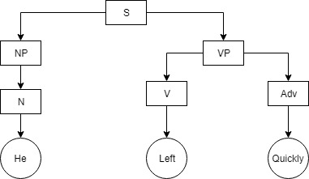
Phrase structure Trees
He left quickly
S ⇒ NP VP
NP ⇒ (det) (adj) N (PP)
PP ⇒ P NP
VP ⇒ V (NP) (PP) (Adv)**

Slide 20
Phrase structure Trees
The big man left quickly
S ⇒ NP VP
NP ⇒ (det) (adj) N (PP)
PP ⇒ P NP
VP ⇒ V (NP) (PP) (Adv)**

Slide 21
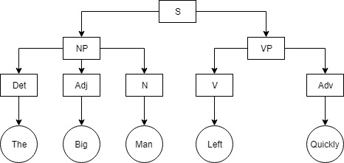
Phrase structure Trees
The big man left quickly
S ⇒ NP VP
NP ⇒ (det) (adj) N (PP)
PP ⇒ P NP
VP ⇒ V (NP) (PP) (Adv)**

Slide 22
Phrase structure Trees
John hit the ball with the bat
S ⇒ NP VP
NP ⇒ (det) (adj) N (PP)
PP ⇒ P NP
VP ⇒ V (NP) (PP) (Adv)**

Slide 23
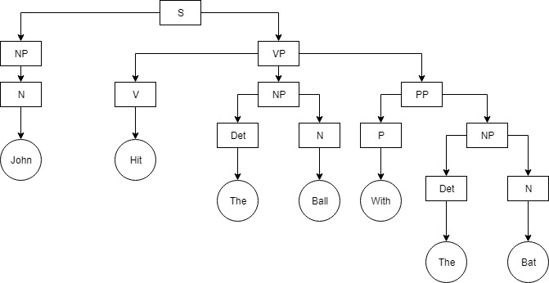
Phrase structure Trees
John hit the ball with the bat
S ⇒ NP VP
NP ⇒ (det) (adj) N (PP)
PP ⇒ P NP
VP ⇒ V (NP) (PP) (Adv)**

Slide 24
Issues with CFG
Global rule structure, Seems perfect for representing syntax

Slide 25
Issues with CFG
Global rule structure, Seems perfect for representing syntax NOT TRUE

Slide 26
Issues with CFG
Global rule structure, Seems perfect for representing syntax NOT TRUE
Reusability is low, everybody has their own grammar

Slide 27
Issues with CFG
Global rule structure, Seems perfect for representing syntax NOT TRUE
Reusability is low, everybody has their own grammar
Cannot build on top of this

Slide 28
Issues with CFG
Global rule structure, Seems perfect for representing syntax NOT TRUE
Reusability is low, everybody has their own grammar
Cannot build on top of this
Cannot represent all flexible language structures

Slide 29
Issues with CFG
Global rule structure, Seems perfect for representing syntax NOT TRUE
Reusability is low, everybody has their own grammar
Cannot build on top of this
Cannot represent all flexible language structures
Cannot be used for evaluating systems

Slide 30
Alternate linguistic structure
Defined by relationships between words
Relations among the words are illustrated with directed, labeled arcs from heads to dependents
Head: a word that governs
Dependent: a word that modifies
Labels: Dependency Relations

Slide 31
Alternate linguistic structure: Example
I prefer the morning flight through Denver

Slide 32
Dependency relations
NSUBJ | Nominal subject
DOBJ | Direct object
NMOD | Nominal modifier
DET | Determiner
CASE | Prepositions, postpositions and other case markers

Slide 33
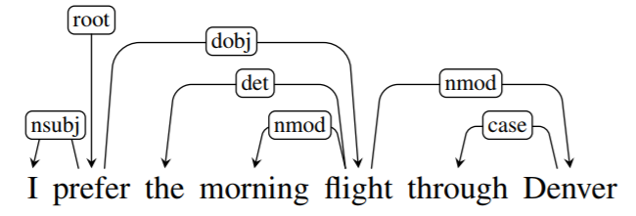
Dependency Structure

Slide 34
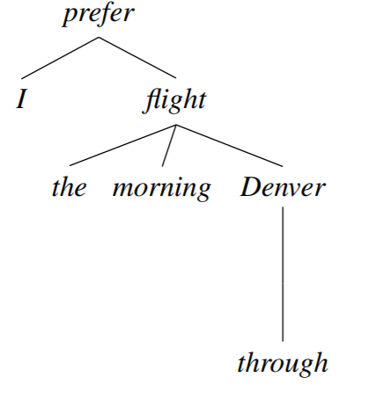
Dependency Tree

Slide 35
Additional Example
John hit the ball with the bat

Slide 36
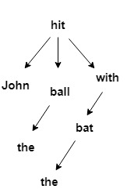
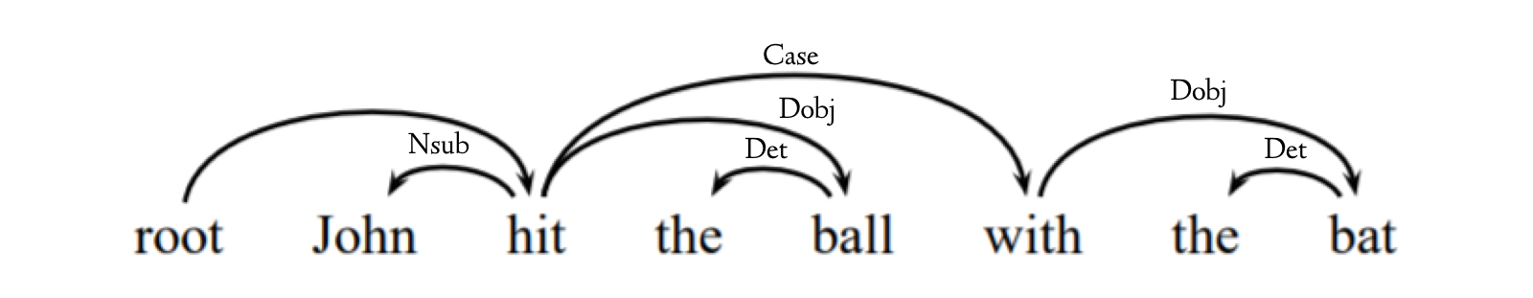
Additional Example: Dependency Tree

Slide 37
Definition: Dependency Tree
A dependency tree is a directed graph that satisfies the following constraints:
1. There is a single designated root node that has no incoming arcs.
2. With the exception of the root node, each vertex has exactly one incoming arc.
3. There is a unique path from the root node to each vertex in V.

Slide 38
Dependency Grammar
A class of modern grammatical theories that are all based on the dependency relation (as opposed to the relation of phrase structure)
Dependency is the notion that linguistic units, e.g. words, are connected to each other by directed links
Dependency grammar approach abstracts away from word-order information, representing only the information that is necessary for the parse

Slide 39
Comparing phrase structure to dependency structure

Slide 40
Advantages of Dependency Grammar over CFG
Very reusable, can build other models on top of this
The head-dependent relations in dependency trees provide an approximation to the semantic relationship between predicates and their arguments
Used for evaluation (Example: Penn treebank formed using dependency trees)
Provides the frequency and distribution of various kinds of sentence that may exist
This makes them directly useful for many applications such as:
question answering
information extraction

Slide 41
Another Example of a Dependency Tree
JetBlue canceled our flight this morning which was already late

Slide 42
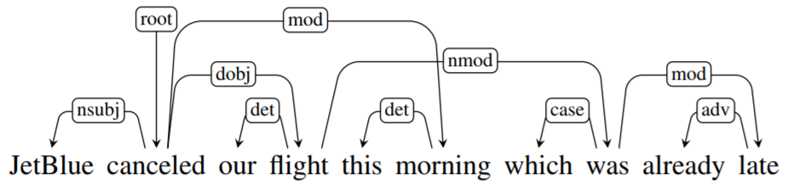
Another Example of a Dependency Tree

Slide 43
Dependency Tree: Types
2 types of dependency trees exist:
Projective Dependency Trees: Do not have crossing arcs
Non-projective Dependency Trees: Contain crossing arcs
Notes:
Types of dep define both here

Slide 44
Dependency Tree: Types
All the examples which we saw prior to the break were examples of projective dependency trees
We cannot draw a dependency tree for the previous sentence in the 2-D plane with no crossing edges - it is a non-projective dependency
In languages with more flexible word order than English, such as German, Dutch and Czech, non-projective dependencies are more frequent
Notes:
Types of dep define both here

Slide 45
The Dependency Parsing Problem
Problem of analyzing a text to produce a grammatical structure with respect to a dependency grammar (word-word relation)
Dependency grammars are distinct from phrase structure grammars (constituency grammars) because they lack phrasal nodes
Dependency structures are flatter than constituency structures, and are thus well suited to languages with free word order
Therefore, there is a need to represent sentences as dependency structures more formally for use in NLP and NLU applications

Slide 46
Eisner Algorithm
Introduced in 1996
A popular algorithm which solves the Dependency Parsing Problem
Data-structure used: spans (complete and incomplete spans)
Approach: Dynamic Programming
Complexity: O(n³)
Algorithm: Works in a bottom-up fashion
Combine adjacent spans into a larger span
Many ways to build spans, hence use the highest scoring combination and store it in the corresponding span

Slide 47
Back to the Dependency Parsing Problem
The Eisner algorithm works only for projective dependency trees
How do we model the Dependency Problem for non-projective dependency trees?
Let us think of a data structure to represent the information that is given to us before we devise an algorithm

Slide 48
Edge Factorization (Model as a Graph)
A given input sentence containing words x₁, . . . , x_{n} is modeled as a graph with each word represented as a node
Every pair of nodes has an edge which has 2 properties:
A weight, w which denotes the strength of the dependency
A feature vector f_{(i, j)}
A feature vector may have several attributes like number of words between head word and dependent, length and direction of dependency, POS bigram features, head and dependent word and POS separately

Slide 49

Edge Factorization (Model as a Graph)
Every edge has a score which is represented as a dot product of the weight of the edge and the feature vector of the edge
i and j represent any pair of nodes which have an edge between them

Slide 50


Mathematical Representation: Edge Factorization
For each sentence x, we construct a directed graph
Where, the vertices and edges are defined as follows:

Slide 51


Intuitive Algorithm
Given a fully connected graph with each edge having a weight and feature vector, we need to find the maximum score possible.
I.e. given kmlk we try to find Any ideas on which algorithm can be used to solve this problem, given the graph data structure that we have?

Slide 52
Crux of this Paper
Core concept: Dependency tree for a given sentence x and spanning tree for its equivalent directed graph G_{x} coincide
Therefore, finding a projective dependency tree with highest score is equivalent to finding the maximum spanning tree in G_{x}
Notes:
Since both trees are required to be rooted at the dummy root and reach all the words.

Slide 53
Basic Idea
Basic Idea: We are starting with a sentence for which we want to find a dependency graph.
Sentence: Set of nodes (words)
Assume: All possible nodes are connected with each other.

Slide 54
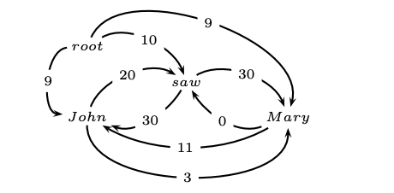

Rules
Gx is a graph with
The sentence words and the dummy root symbol as vertices
A directed edge between every pair of distinct words
A directed edge from the root symbol to every word.

Slide 55
Chu-Liu-Edmond’s Algorithm
Each vertex in the graph greedily selects the incoming edge with the highest weight
If a tree results, it must be a maximum spanning tree
If not, there must be a cycle
Identify the cycle and contract it into a single vertex
Recalculate edge weights going into and out of the cycle

Slide 56
Chu-Liu-Edmond’s Algorithm
Step 1: We build the directed graph with the given edge weights.

Slide 57
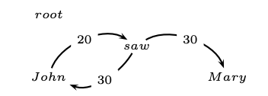
Chu-Liu-Edmond’s Algorithm
Step 2: Find the highest scoring incoming edge for each word.
If this is a tree, we have found our MST.

Slide 58
Chu-Liu-Edmond’s Algorithm
Step 3: Contract the cycle into a single node and recalculate the edge weights.
Outgoing edges: Max of the outgoing arcs over all vertices in the cycle.
Incoming Edges: Equal to the best spanning tree that includes head of the incoming arc and all the nodes in the cycle.

Slide 59
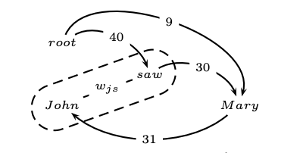
Chu-Liu-Edmond’s Algorithm
Outgoing edge : Node to Mary
John ⇒ Mary = 3
Saw ⇒ Mary = 30
Incoming edge: Root to Node
Root ⇒John ⇒ Saw = 9+20 = 29
Root⇒ Saw⇒John= 10+30 = 40
Incoming edge: Mary to Node
Mary ⇒ John ⇒ Saw = 11+20 = 31
Mary ⇒ Saw ⇒ John = 0+30 = 30

Slide 60
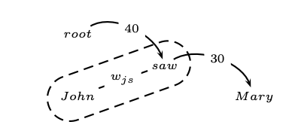
Chu-Liu-Edmond’s Algorithm
Now we apply the Chu-Liu_Edmond algorithm again, on the contracted graph:
Select the incoming edge with the maximum weight.
We have a maximum spanning tree! (YAY!)

Slide 61
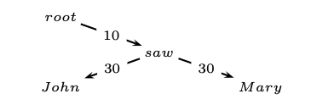
Chu-Liu-Edmond’s Algorithm
For reconstruction: we go back one step recursive call and see how we constructed the connections to get back the original graph.
Outgoing edge: Saw ⇒ Mary =30
Incoming edge: Root ⇒ Saw ⇒ John
Root ⇒ Saw = 10
Saw ⇒ John = 30
Thus we reconstruct the tree => Maximum Spanning Tree => Dependency Graph.

Slide 62
Need for a Learning Algorithm
Edges are associated with “feature vectors” and “weights”

Slide 63
Need for a Learning Algorithm
Edges are associated with “feature vectors” and “weights”
Feature Vectors are based on the nodes being connected and the label associated

Slide 64
Need for a Learning Algorithm
Edges are associated with “feature vectors” and “weights”
Feature Vectors are based on the nodes being connected and the label associated
Weights need to be learned

Slide 65
Need for a Learning Algorithm
Edges are associated with “feature vectors” and “weights”
Feature Vectors are based on the nodes being connected and the label associated
Weights need to be learned
What weights will help find the best spanning tree?

Slide 66
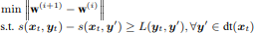
MIRA: The Online Learning Algorithm
Training set: (x,y) where x = sentence and y= correct dependency tree
Dt(x) are the possible dependency tree space associated with x
Parameters updated for each training sample
Choose an update size that fixes the current mistake but also doesn’t significantly change the weight
Can be modelled as an optimization problem:
Correct label should have a higher score
Loss: number of words with incorrect parents relative to the correct tree
Notes:
Current training example classified with margin against incorrect classifications atleast as large as their loss. Therefore change of parameters kept as small as possible

Slide 67
MIRA: Updated
Computationally intensive (Exponential blow up)
Single Best MIRA: Relaxed Constraint
Can be extended to k-best
Factored MIRA: Removal of Loss
Seperation with Margin of size 1 between weights of correct incoming edge and all other incoming edges
Correct and all incorrect spanning tree seperated by a score as large as atleast the number of incoming edges

Slide 68
Experiments
Czeck POS Tagging with Czeck Dependency Bank
More flexible word order, lots of non projective dependencies
Additional Optional tags: Gender, Case

Slide 69
Results
Metrics
Accuracy: Words that correctly identified their parents
Completeness: Number of sentences in which the resulting tree was completely correct

Slide 70
Results
Metrics
Accuracy: Words that correctly identified their parents
Completeness: Number of sentences in which the resulting tree was completely correct
Datasets with non-projective dependency perform better

Slide 71
Results
Metrics
Accuracy: Words that correctly identified their parents
Completeness: Number of sentences in which the resulting tree was completely correct
Datasets with non-projective dependency perform better
Complexities: Chiu Lu (O(n^2)) and Eisner (O(n^3))

Slide 72
Results
Metrics
Accuracy: Words that correctly identified their parents
Completeness: Number of sentences in which the resulting tree was completely correct
Datasets with non-projective dependency perform better
Complexities: Chiu Lu (O(n^2)) and Eisner (O(n^3))
Chiu Lu might seem like an overkill: MIRA simplifies it significantly

Slide 73
Results
Metrics
Accuracy: Words that correctly identified their parents
Completeness: Number of sentences in which the resulting tree was completely correct
Datasets with non-projective dependency perform better
Complexities: Chiu Lu (O(n^2)) and Eisner (O(n^3))
Chiu Lu might seem like an overkill: MIRA simplifies it significantly
But Chiu Lu performs worse on datasets with only projective dependencies

Slide 74
Results
Metrics
Accuracy: Words that correctly identified their parents
Completeness: Number of sentences in which the resulting tree was completely correct
Datasets with non-projective dependency perform better
Complexities: Chiu Lu (O(n^2)) and Eisner (O(n^3))
Chiu Lu might seem like an overkill: MIRA simplifies it significantly
But Chiu Lu performs worse on datasets with only projective dependencies
Factored MIRA >>> Single Best MIRA

Slide 75
Summary
Equivalence of dependency trees and maximum spanning trees
Parsing: Eisner’s or Chiu Lu, Learning: MIRA
Unlike previous models, Non projective is the simpler solution

